Slide 1
PROTOTYPE DEVELOPMENT II
SESSION X
FINANCE & PERCEPTUAL MAP

Slide 2
Learning Objectives
LO 1 : Design physical / visual representation and constructive breakthrough of business ideas

Slide 3
Subtopics
Revenue Streams
Cost Structure
Perceptual Maps

Slide 4
Revenue Streams

Slide 5

Revenue Streams
The Revenue Streams Building Block represents
the cash a company generates from each Customer
Segment

Slide 6
Types of Revenue Streams
Transaction revenues resulting from one-time customer payments
Recurring revenues resulting from ongoing payments to either deliver a Value Proposition to customers or provide post-purchase customer support

Slide 7
Several Ways to
Generate Revenue Streams
Asset sale
Usage fee
Subscription fee
Lending / Renting / Leasing
Licensing
Brokerage fee
Advertising

Slide 8
Cost Structure

Slide 9

Cost Structure
The Cost Structure describes all costs incurred to
operate a business model

Slide 10
Classes of Business Model
Cost Structure
Cost-Driven
Value-Driven
focus on minimizing costs wherever possible
focus on value creation
e.g.: Citilink
e.g.: Garuda Indonesia

Slide 11
Cost Structure Characteristics
Fixed Costs
Variable Costs
Economies of Scale
Economies of Scope

Slide 12
Perceptual Map

Slide 13
Perceptual Map
A perceptual map is the visual technique designed to show how the average target market consumer understands the positioning of the competing products in the marketplace

Slide 14
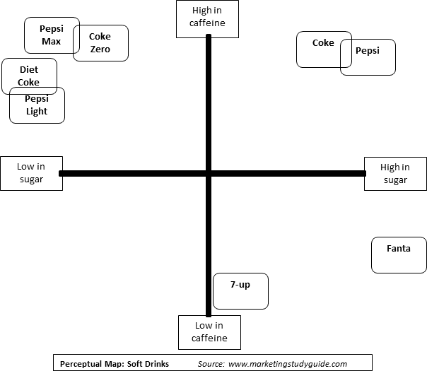
Main Types of Perceptual Map
1. Using two determinants attributes

Slide 15
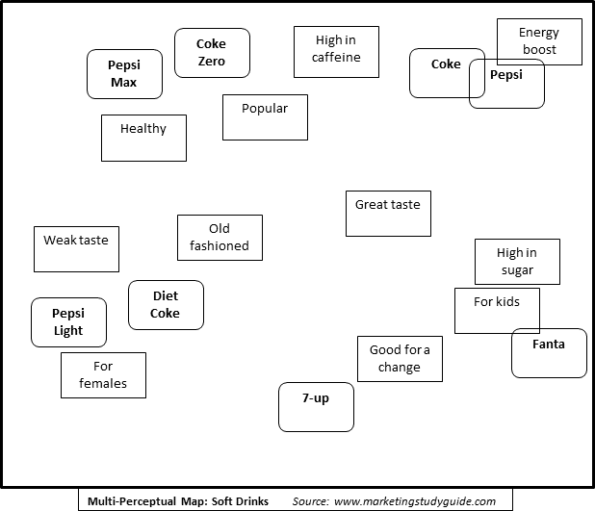
Main Types of Perceptual Map
2. Using many product attributes

Slide 16
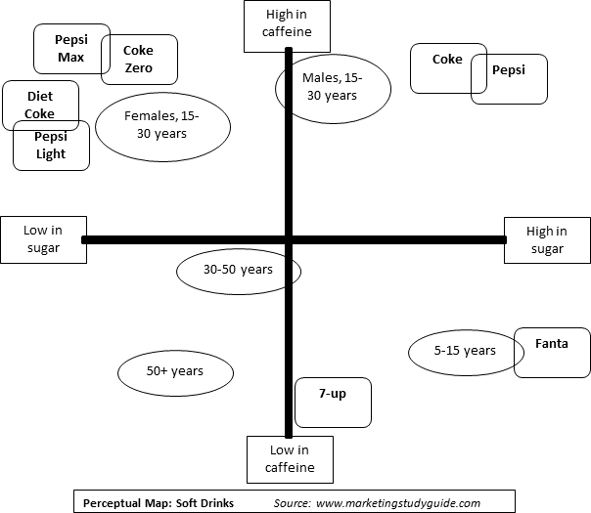
Main Types of Perceptual Map
3. Joint Perceptual Maps

Slide 17
Why Perceptual Map?
We get a true understanding of how our brand is perceived in the marketplace
We can track how the perception of our brand is evolving over time, with new products and campaigns
We can track the perception of competitor products and measure the impact of their marketing strategies

Slide 18
Why Perceptual Map?
We can identify positioning preferences (i.e ideal combination of product attributes) for different market segments
We can identify possible gaps and opportunities for new products
We can identify possible opportunities for repositioning our brand

Slide 19
Student Activities

Slide 20
Student Activities
Coaching session: Students discuss about the financial and positioning part of their business

Slide 21
Session 13 Preparation

Slide 22
Session 13 Preparation
Learn Infographic
Create business infographic draft, consists of:
Value Proposition Canvas
Problem and Solutions
Products / Services
Products / Services Function
Products / Services Features
Key Resources
Cost Structure
Competitive advantages compared to competitors
Key Partnership
The final version of the infographic will be submitted max. 1 week after session 13
The Infographic score will be Assignment III: 40% of the assignment score

Slide 23
References
Osterwalder, A., & Pigneur, Y. (2010). Business model generation: a handbook for visionaries, game changers, and challengers. John Wiley & Sons
https://www.segmentationstudyguide.com/understanding-perceptual-maps/perceptual-maps/
https://www.youtube.com/watch?v=xJUrBylId7I

